Slide 1
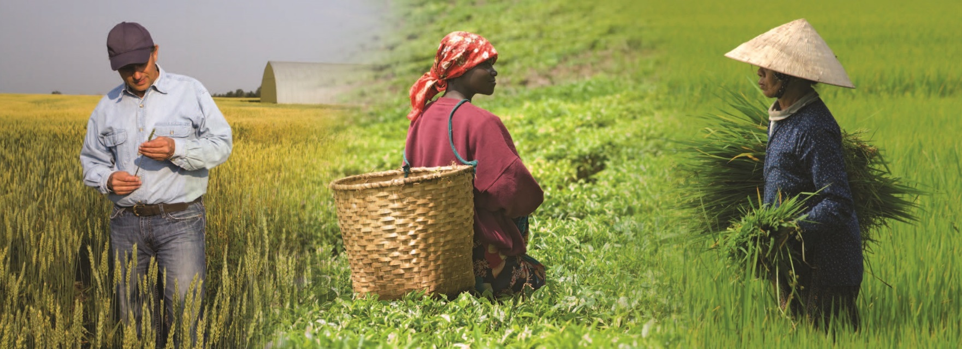
Notes:
Lesson 5: Fertilizers and the Environment
Nourishing the Planet in the 21st Century
Page 152-168
Download your free copy of the curriculum: https://www.nutrientsforlife.org/for-teachers.
Students consider what happens when plants do not get adequate amounts of their essential nutrients. They play the role of plant doctor diagnosing the cause of a nutrient deficiency. Students then consider the role of fertilizer in a global context. They investigate how fertilizers can help feed people while protecting the environment. The consequences of misusing fertilizers also are considered.
Topics Covered and Major Concept
Explain-Elaborate: Students apply their understanding of fertilizers to a global scale and consider how fertilizer use affects the environment. Fertilizers increase the amount of food and fiber produced per acre thereby reducing the amount of land needed for farming. Our growing population demands that more food be produced. Unless crop yields keep pace with the demand, more land will have to be used for agriculture.
Alignment with Next Generation Science Standards
Science Practices in Lesson 5
Planning and Carrying Out Investigations
Analyzing and Interpreting Data
Using Mathematics and Computational Thinking
Constructing Explanations and Designing Solutions
Engaging in Argument from Evidence
Obtaining, Evaluating, and Communicating Information
Selected Disciplinary Core Ideas in Lesson 5
LS1.A: STRUCTURE AND FUNCTION: Systems of specialized cells within organisms help them perform the essential functions of life.
LS1.C: ORGANIZATION FOR MATTER AND ENERGY FLOW IN ORGANISMS: The process of photosynthesis converts light energy to stored chemical energy by converting carbon dioxide plus water into sugars plus released oxygen.
LS1.C: ORGANIZATION FOR MATTER AND ENERGY FLOW IN ORGANISMS: As matter and energy flow through different organizational levels of living systems, chemical elements are recombined in different ways to form different products.
LS2.B: CYCLES Of MATTER AND ENERGY TRANSFER IN ECOSYSTEMS: Photosynthesis and cellular respiration are important components of the carbon cycle, in which carbon is exchanged among the biosphere, atmosphere, oceans, and geosphere through chemical, physical, geological, and biological processes.
LS1:C: Organization for Matter and Energy Flow in Organisms: The sugar molecules thus formed contain carbon, hydrogen, and oxygen, their hydrocarbon backbones are used to make amino acids and other carbon-mased molecules that can be assembled into larger molecules (such as proteins or DNA) used, for example, to form new cells.
LS2.B: Cycles of Matter and Energy Transfer in Ecosystems: The chemical elements that make up the molecules of organisms pass through food webs and into and out of the atmosphere and soil, and recombine in different ways.
LS2.C: Ecosystem Dynamics, Functioning, and Resilience: Moreover, anthropogenic changes (induced by human activity) in the environment – including habitat destruction, pollution, introduction of invasive species, overpopulation, and climate change – can disrupt an ecosystem and threaten the survival of some species.
LS4.d: BIODIVERSITY AND HUMANS: Humans depend on the living world for the resources and other benefits provided by biodiversity. But human activity is also having adverse impacts on biodiversity through overpopulation, overexploitation, habitat destruction, pollution, introduction of invasive species, and climate change.
ESS3.C: HUMAN IMPACTS ON EARTH SYSTEMS:
The sustainability of human societies and the biodiversity that supports them require responsible management of natural resources.
ETS1.A: DEFINING AND DELIMITING ENGINEERING PROBLEMS: Humanity faces major global challenges today, such as the need for supplies of clean water and food or for energy sources that minimize pollution, which can be addressed through engineering. These global challenges also may have manifestations in local communities.
ETS1.B: DEVELOPING POSSIBLE SOLUTIONS: When evaluating solutions it is important to take into account a range of constraints, including cost, safety, reliability, and aesthetics and to consider social, cultural, and environmental impacts.
Crosscutting Concepts in Lesson 5
Scale, Proportion and Quantity
Systems and System Models
Energy and Matter in Systems
Stability and Change of Systems
Common Core Standards in Lesson 5
English Language Arts/Literacy
Anchor Standards
CCSS.ELA-LITERACy.CCRA.R.1
CCSS.ELA-LITERACy.CCRA.R.2
CCSS.ELA-LITERACy.CCRA.R.7
CCSS.ELA-LITERACy.CCRA.R.10
CCSS.ELA-LITERACy.CCRA.W.1
CCSS.ELA-LITERACy.CCRA.W.2
CCSS.ELA-LITERACy.CCRA.W.4
CSS.ELA-LITERACy.CCRA.W.9
CCSS.ELA-LITERACy.CCRA.SL.1
CCSS.ELA-LITERACy.CCRA.SL.2
CCSS.ELA-LITERACy.CCRA.SL.4
CCSS.ELA-LITERACy.CCRA.L.4
CCSS.ELA-LITERACy.CCRA.L.6
Math Standards
Standards for Mathematical Practice
CCSS.mATH.PRACTICE.mP1
CCSS.mATH.PRACTICE.mP2
CCSS.mATH.PRACTICE.mP3
CCSS.mATH.PRACTICE.mP4
CCSS.mATH.PRACTICE.mP6
The Nutrients for Life Foundation provides a search tool on their website, http://www.nutrientsforlife.org, allowing teachers to select their state and find soil science lessons that correlate with their state’s science standards. The search tool can align this curriculum with science standards for all 50 states, National Sciences Education Standards, Common Core State Standards, and Next Generation Science Standards.
The Explain lessons (Lesson 5, Fertilizers and the Environment), provide opportunities for students to connect their previous experiences with current learning and to make conceptual sense of the main ideas of the module. This phase also allows for the introduction of formal language, scientific terms, and content information that might make students’ previous experiences easier to describe. The Explain lesson encourages students to explain concepts and ideas (in their own words) about how plants obtain nutrients and how fertilizers affect the environment; listen to and compare the explanations of others with their own; become involved in student-to-student discourse in which they explain their thinking to others and debate their ideas; revise their ideas; record their ideas and current understanding; use labels, terminology, and formal language; and compare their current thinking with what they previously thought.
ELABORATE
In Elaborate lessons, students apply or extend previously introduced concepts and experiences to new situations. In the Elaborate lessons in this module (Lesson 5, Fertilizers and the Environment), students make conceptual connections between new and former experiences, connecting aspects of their plant and soil investigations with their concepts of scientific inquiry; connect ideas, solve problems, and apply their understanding to a new situation; use scientific terms and descriptions; draw reasonable conclusions from evidence and data; deepen their understanding of concepts and processes; and communicate their understanding to others.

Slide 2
Fertilizers and the Environment
Lesson 5
Explain-Elaborate
Notes:
Overview
An apple is used to model Earth. Students learn that just 1/32 of its surface is devoted to farmland. Students use estimates of population growth and land use to calculate how much additional farmland will be needed in the future. They discuss what sacrifices may be needed to feed a larger population. Nutrient pollution is defined, and students discuss ways of limiting it.
Major Concepts
• Only a small portion of Earth’s surface is used to grow food.
• The world population is growing at a steady rate.
• Unless food productivity increases, more land will have to be farmed.
• Fertilizers help increase food productivity.
• Fertilizers can be commercial or organic.
• Excesses and deficiencies in nutrients can have negative impacts on water, soil, and air.
Teacher Background
Consult the following sections in Teacher Background:
10.0 NOURISHING PLANTS WITH FERTILIZERS,
12.0 FERTILIZERS AND THE ENVIRONMENT,
13.0 TECHNOLOGY AND THE FUTURE Of AGRICULTURE

Slide 3
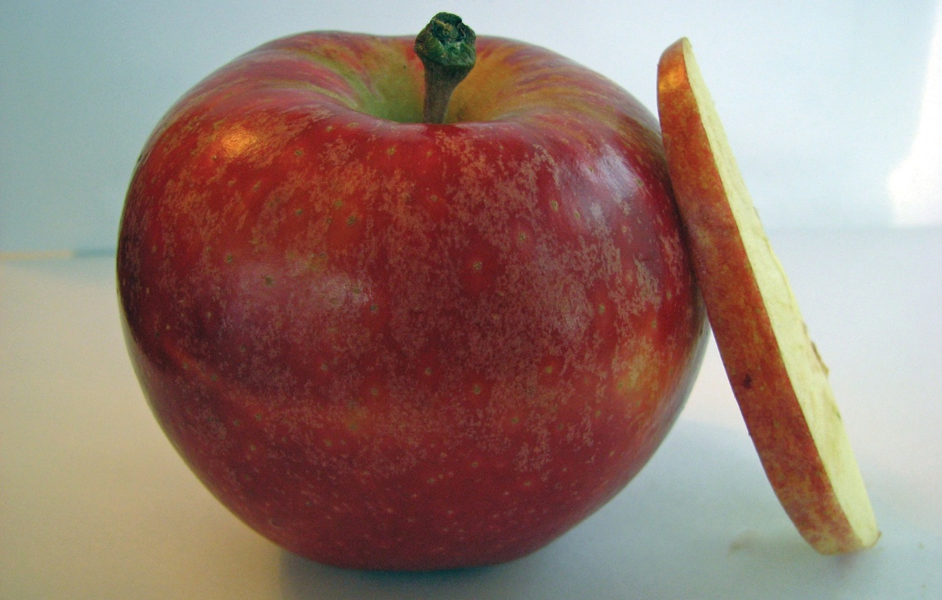
What we’re learning!
By the end of this lesson, you will be able to
recognize that farmland is a finite resource,
appreciate that the world’s growing population demands an increase in food productivity,
describe the role fertilizer plays in increasing food productivity,
distinguish between organic and commercial fertilizers, describe how excess nutrients are harmful to the environment, and
identify different sources of nutrient pollution.
Notes:
Objectives
After completing this lesson, students will be able to
recognize that farmland is a finite resource,
appreciate that the world’s growing population demands an increase in food productivity,
describe the role fertilizer plays in increasing food productivity,
distinguish between organic and commercial fertilizers,
describe how excess nutrients are harmful to the environment, and
identify different sources of nutrient pollution.

Slide 4
Virtual Classroom – Lesson Introduction
Notes:
For more virtual classroom videos, visit the Nutrients4Life YouTube channel.

Slide 5
What are some of the most important uses for land?”
Farming
Homes
Industries or places where we work
Pastures or land for livestock
Parks, sports, and recreation
Mining
Wildlife habitat (mountain ranges, jungles, deserts, beaches, and tundra)
Notes:
Activity 1: The Big Apple (page 154)
Teacher’s Note: In this activity, students consider the challenges associated with the Earth’s growing population and land use.
This activity uses an apple as a model of Earth. Students discuss the various ways people use land and make predictions about what percentage of Earth’s land is needed to grow our food. After discussing the ways in which land is used (Step 2), you may consider having the students create their own pie charts where they predict the percentages associated with different land uses, especially farming. Later, their predictions can be compared with the actual values revealed by the apple demonstration.
Explain to the class that this activity is about how we, as a society, use land. The amount of land on earth stays the same and as the world’s population gets larger, it becomes even more important that we make wise decisions about how it is used.
Explain that land is used for many different reasons. ask, “what are some of the most important uses for land?” Write students’ responses on the board or chart paper.
Students’ responses may include the following:
farming
homes
industries or places where we work
pastures or land for livestock
parks, sports, and recreation
mining
wildlife habitat (mountain ranges, jungles, deserts, beaches, and tundra)
If students do not mention these kinds of uses, ask guiding questions to encourage them to think about how humans use land. A student may point out that some land, such as a desert, has no use. Of course, any land that is not being used by humans can be considered a habitat for wildlife, which can also lead to enjoyment by humans. Student responses to this question give you an idea of how aware they are of the diverse demands placed on land resources.

Slide 6
Notes:
Call attention to the apple and the knife. Explain that the apple represents earth. Ask, “How much of earth’s surface do you think is devoted to farming?” Students’ responses will vary. Some may remember that about 70 percent of the surface is water.
Use the knife to cut the apple into 4 equal parts. All cuts should be made long-ways. Set 3 parts aside and hold up the remaining one quarter. Explain that the surface of the world is about 70 percent water, so this piece represents that part of the surface that is land.
Remind students that this relatively small amount of land must be put to many different uses.
Use the knife to cut the one quarter piece of apple in half 3 more times, each time discarding 1/2. Finally, hold up 1 of the smallest pieces and explain that it represents 1/32 of the surface of earth. This is the amount of land used for farming. Point out that the skin on this small piece of apple represents the tiny layer of topsoil that we depend on to grow food.
Explain that because we put land to so many different uses, the amount devoted to farming has hardly changed during the past 50 years. Scientists are worried about how we will feed the world’s growing population in the future.
Although additional land has been cleared for farming in many developing countries, it has largely been offset by a reduction of farmland in the developed countries.

Slide 7
Study Forecasts Food Shortage THE DAILY HERALD SPECIAL EDITION, DECEMBER 14
A new study published in the Journal of World Agriculture raises concerns that in the future there will not be enough food for the world’s growing population. The study was carried out by an international group of scientists with support from the Earth Food Bank. According to the study, the population of the world is increasing by about 80 million people each year.
To feed the growing population, crop yields will need to increase significantly. The researchers listed many factors that limit food production but singled out two for special consideration. First, the amount of freshwater available for farming is projected to limit food production. Second, higher temperatures around the world are already causing large losses in grain yields among the world’s major producers. The study concluded by recommending that the Earth Food Bank sponsor a program dedicated to setting priorities and establishing policies that will enable all of the world’s people to be fed.
Notes:
Activity 2: Using Land Wisely (page 155)
In this activity, students use a world population projection to consider how much additional farmland will be needed to feed humans in the year 2050. Remind the students that in Lesson 4 they were concerned with diagnosing and treating plant nutrient deficiencies in a small African village. The aim was to increase food production for the local inhabitants. In this activity, the focus broadens to consider how we can feed the entire world’s population. Display Master 5.1 (page 162), newspaper articles and reveal only the top article. ask a student volunteer to read the article aloud.
Explain to students that they will continue in their roles as agricultural experts concerned with increasing crop yields on farms.
Ask students to summarize the content of the article. Try to focus the discussion on the world. Most students in the United States do not have direct experience with severe hunger. Help them understand that in addition to human suffering, hunger can also lead to unstable governments, wars, and threats to national security—including that of the United States. It is in everyone’s best interest to eliminate world hunger.
The article states that population growth contributes to the problem of world hunger. Do not dwell on population- control measures. The students are working as agricultural experts and need to focus on how to grow more and better food. The article also mentions availability of freshwater and increasing temperatures as challenges for growing more food. If students do not understand why increasing temperatures cause lower crop yields, explain that it takes more energy for plants (and people) to maintain themselves at higher temperatures. Using humans as an example, you can point out that marathon records are usually set at cooler temperatures.

Slide 8
Earth Food Bank to Hold Meeting on Food Production THE DAILY HERALD MORNING EDITION, MARCH 17
In response to a recent international study on population and food production, the secretary general of the Earth Food Bank has announced that it will sponsor a series of two-week-long conferences next summer to address world hunger. Attendees at each conference will discuss a different aspect of the problem and make recommendations for meeting the world’s food needs.
According to the study, the four major aspects of the problem are
reducing carbon emissions that contribute to increasing Earth’s temperature,
stabilizing population growth,
making better use of our water resources, and
increasing the crop yields on farms.
An international group of experts will attend each conference. The experts will submit a report to the secretary general that describes their recommendations. Scientists from Humanity Against Hunger will organize the conference on increasing crop yields. These scientists have experience applying modern agricultural practices in developing countries.
Notes:
Page 162
Ask students to summarize the article. Students should recognize that there are many factors that influence world hunger and that addressing the problem requires the skills of many different types of professionals including social scientists, climatologists, water management experts, and agricultural experts.
Divide the class into teams of 3 students.
Explain that their first task is to investigate how population growth is expected to affect farming in the future.

Slide 9
Source: United Nations, Department of Economic and Social Affairs, Population Division (2013). World Population Prospects: The 2012 Revision, Volume I: Comprehensive Tables ST/ESA/SER.A/336. http://esa.un.org/unpd/wpp/index.htm
Notes:
The population graph provides data about the world population from 1950 and projections for the population in the year 2100. The high, medium, and low estimates of the future world population are based on fertility rates (the number of children that people have).
Instruct some teams to use the high estimate in their calculations, others the medium estimate, and the rest the low estimate.
Switch out the graph with updated population statistics if appropriate.

Slide 10
Notes:
The value of 12 percent of land devoted to farming refers to the world as a whole. Obviously, the corresponding figures for different countries vary considerably. This activity is designed to examine the problem of feeding the world and not to explore the situations within individual countries.
Give teams 10 minutes to perform their calculations. The numbers needed to perform the calculations can be estimated from the population graph.

Slide 11
Part A: How much farmland is used to feed each person today?
STEP 1. Use the World Population Growth graph to estimate Earth’s population right now: billion people.
STEP 2. The 11 percent of land devoted to farming corresponds to 3.5 billion acres of farmland.
STEP 3. Divide the 3.5 billion acres of farmland by the population (from Step 1) to get the number of acres of farmland per person:
3.5 Billion Acres Farmland ÷ _____ Billion People = ____ Acres Per Person
Notes:
Page 164
Source: United Nations, Department of Economic and Social Affairs, Population Division (2013). World Population Prospects: The 2012 Revision, Volume I: Comprehensive Tables ST/ESA/SER.A/336. http://esa.un.org/unpd/wpp/index.htm
Ask, “How much farmland is used to feed each person today?“
Use the World Population Growth graph on Master 5.2, Population and Land Use Graphs (page 163) to estimate Earth’s population right now: 7.1 billion people (in January 2014). Refer to the 12 percent of land devoted to farming corresponds to 3.5 billion acres of farmland.
Divide the 3.5 billion acres of farmland by the population (from Step 1) to get the number of acres of farmland per person:
3.5 billion acres farmland ÷ 7.1 billion people = 0.5 acres per person

Slide 12
PART C: Assuming that crop yields stay the same, how much additional land will be needed for farming in 2050?
STEP 1. Calculate the estimated population increase factor from now to 2050:
Population in 2050 (from part b) ÷ population now (from part A)=_______
STEP 2. Multiply the 3.5 billion acres of farmland times the population increase factor (from Step 1):
3.5 billion acres farmland × population increase factor = _____ billion acres farmland needed in 2050
STEP 3. To find out how much extra farmland will be needed in 2050, subtract the 3.5 billion acres (today’s farmland) from the number of acres needed in 2050 (from Step 2):
_____ billion acres needed in 2050 – 3.5 billion acres = ______ billion extra acres of farmland needed
Notes:
PART C: Assuming that crop yields stay the same, how much additional land will be needed for farming in 2050?
STEP 1. Calculate the estimated population increase factor from now to 2050:
population in 2050 (from Part B) ÷ population now (from Part A)
1.54 (high estimate)
1.35 (medium estimate)
1.16 (low estimate)
STEP 2. Multiply the 3.5 billion acres of farmland times the population increase factor (from Step 1):
3.5 billion acres farmland × population increase factor =
5.39 billion acres farmland needed in 2050 (high estimate)
4.73 billion acres farmland needed in 2050 (high estimate)
4.06 billion acres farmland needed in 2050 (high estimate)
STEP 3. To find out how much additional farmland will be needed in 2050, subtract the 3.5 billion acres (today’s farmland) from the number of acres needed in 2050 (from Step 2):
5.39 billion acres needed in 2050 – 3.5 billion acres = 1.89 billion
extra acres of farmland needed (high estimate)
4.73 billion acres needed in 2050 – 3.5 billion acres = 1.23 billion
additional acres of farmland needed (medium estimate)
4.06 billion acres needed in 2050 – 3.5 billion acres = 0.56 billion
additional acres of farmland needed (low estimate)
Ask each team to report the results of their calculations. write their answers on the board or chart paper.
If any answers are out of the expected range, go through the calculation systematically, identify the mistake, and correct it. Obtain answers using the high, medium, and low population estimates.
Ask students to summarize the results.
If students do not point this out, emphasize that if crop yields stay the same between now and 2050, then perhaps an extra 1 billion acres of farmland will need to be set aside and cultivated.
Ask the students to remember the different uses of land that they described in step 2 of Activity 1, THE BIG APPLE.
Point to the list of land uses that students created in Activity 1.

Slide 13
Discussion: If a billion acres of extra farmland are needed to feed the world’s population, from where should it come? What are you willing to sacrifice?
Notes:
Ask, “If a billion acres of extra farmland are needed to feed the world’s population, from where should it come? What are you willing to sacrifice?”
Students likely will believe that people must have adequate land for the places where they live and work. They may suggest taking the land from parks or wildlife habitats. Some may suggest that if more people became vegetarians, the extra farmland could come from pastures where livestock graze.
These questions are not intended to settle the issue. Instead, they are intended to prompt a discussion that helps students see the scope of the problem and to consider some of the difficult decisions that may lie ahead. This step gives you a sense of the students’ awareness of the tradeoffs associated with the reallocation of limited resources.
Explain that in the next activity, they will consider how farming practices can influence land use and crop yields.

Slide 14
What will be the effect of increasing the amount of food that an acre of farmland can produce?
Notes:
Activity 3: Fertilizers and the Future (page 157)
In this activity, students identify advantages and disadvantages of using organic and commercial fertilizers. They also consider how to minimize nutrient pollution. The readings about organic and commercial fertilizers are brief. The information is not meant to be comprehensive. Rather, it is designed to challenge students’ critical-thinking skills and provide opportunities for them to construct explanations supported by evidence.
Remind students that in activity 2, using land wisely, they calculated that approximately 1 billion extra acres of farmland would be needed to feed the world’s population in 2050.
Ask, “What were two assumptions made in reaching this conclusion?” Students’ answers will vary. Some may focus on assumptions associated with the rate of population growth. This is a good answer, but you should guide the discussion to remind students that their calculations assumed that the crop yields from farms would remain constant between now and 2050.
Ask, “What will be the effect of increasing the amount of food that an acre of farmland can produce?” Students should realize that if farmland becomes more productive, then fewer acres would be required to meet the world’s food needs.

Slide 15
Proper Application of Fertilizer
Fertilizer is added at the right time. Fertilizers should be applied during that part of the plant’s life cycle when the nutrients are needed.
Fertilizer is added at the right place. Fertilizers should be applied in a location where the nutrients can be taken up by the plant’s root system.
Fertilizer is added at the right rate. Fertilizers should be applied at the rate at which the plant can use the nutrients.
Notes:
Explain that in their roles as agricultural experts, they are going to make recommendations to the Earth Food Bank about how to farm in the future. Explain to students that when considering the proper use of fertilizer, they want to increase crop yields, while at the same time minimizing harm to the environment.
Proper application of fertilizer means the following:
Fertilizer is added at the right time. Fertilizers should be applied during that part of the plant’s life cycle when the nutrients are needed.
Fertilizer is added at the right place. Fertilizers should be applied in a location where the nutrients can be taken up by the plant’s root system.
Fertilizer is added at the right rate. Fertilizers should be applied at the rate at which the plant can use the nutrients.

Slide 16
Organic Fertilizer
Advantages
Disadvantages
Notes:
Explain that students need to learn more about fertilizers and their effects on the environment. Pass out to half of the teams a copy of Master 5.4, Thinking about Fertilizers (page 165) and a copy of 5.5, Pros and Cons of Different Fertilizers (page 166).
Pass out to the other teams a copy of Master 5.6, Nutrient Pollution (page 167) and a copy of Master 5.7, Nutrient Pollution Discussion Questions (page 168).
Instruct the teams to read the information found on the first handout (either Master 5.4, Thinking about Fertilizers or Master 5.6, Nutrient Pollution) and to discuss within their teams their understanding. Students should relate the ideas of “right time, right place, and right rate” when considering the use of fertilizers and their impacts on the environment. Students should use the second handout (either Master 5.5, Pros and Cons of Different Fertilizers or Master 5.7, Nutrient Pollution Discussion Questions) to record their conclusions.
Students reading about fertilizers should be able to identify 3 or 4 advantages and disadvantages of each type of fertilizer. Students reading about nutrient pollution should be able to describe how excess nutrients can produce algal blooms that use up oxygen in waterways, leading to suffocation of other plants and animals. They should be able to identify wastewater treatment facilities and industrial plants as point sources of nutrient pollution. They should identify urban development, septic systems, the burning of fossil fuels, and agricultural runoff as nonpoint sources of nutrient pollution. Student suggestions for limiting nonpoint sources of nutrient pollution will vary. There is no simple correct answer. Look for logical responses that students can defend using evidence. The idea is to get them thinking about the multiple sources of nutrient pollution and for them to realize that minimizing it will require a complex set of regulations, incentives, and government oversight.
After the teams have completed their tasks, ask volunteers to read their conclusions and fill in the following four slides as a class. Discuss answers to the questions about nutrient pollution.

Slide 17
Commercial Fertilizer
Advantages
Disadvantages

Slide 18
Nutrient Pollution Discussion Questions
Why are excessive amounts of nutrients bad for the environment?
What is the difference between a point source and a nonpoint source of nutrient pollution? List two examples of each type of source.
What are some ways to limit nutrient pollution from nonpoint sources?
Notes:
Ask, “Why do you think that some farmers use organic fertilizers and others use commercial fertilizers?” Student responses will vary. Try to bring out in the discussion that the farmers in the United States have more options than farmers in poorer countries who may have no choice but to use organic fertilizers that they produce for themselves. One consequence is that farmers in poorer countries often obtain lower crop yields as compared with farmers in the United States.
Teacher Note
Try to avoid getting bogged down in debating whether or not food that is organically grown is safer or tastes better than food grown using commercial fertilizers. This is not the focus of the lesson. Scientific studies have not been able to find consistent taste, health, or safety differences between foods grown using the two types of fertilizers.
Conclude the lesson by asking students to hold on to their handouts. Explain that they will refer to them during the next lesson when they will be making recommendations for farming in the future.

