Slide 1
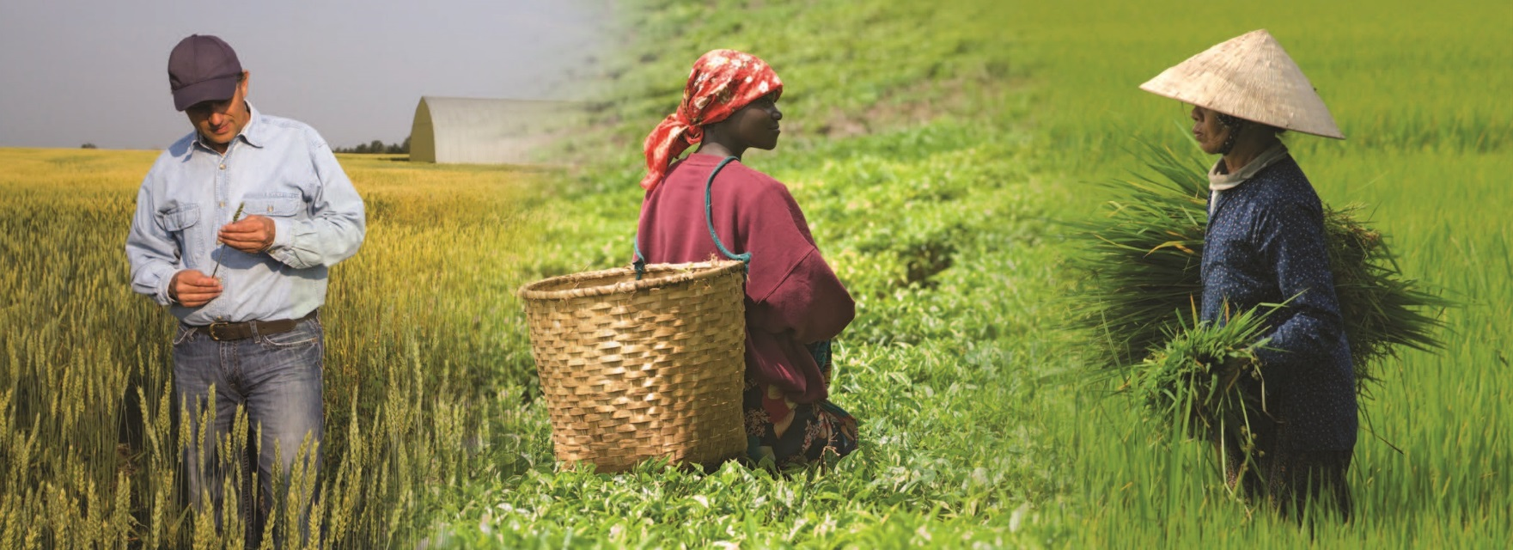
Notes:
Lesson 3: Plant-Soil Interaction
Nourishing the Planet in the 21st Century
Download your free copy of the curriculum: https://www.nutrientsforlife.org/for-teachers
Topics Covered and Major Concept
LESSON 3, PLANT-SOIL INTERACTIONS - Students then turn their attention to plant anatomy. They explore the role of the root system as well as that of the xylem and phloem tissues. They conduct a hands-on activity that shows how nutrients move by diffusion.
Plants extract nutrients from the soil. Nutrients enter the root system largely by diffusion. Water and food transport use the xylem and phloem tissues respectively.
Page 90-114
TEACHER BACKGROUND
Alignment with Next Generation Science Standards
Science Practices in Lesson 3
Asking Questions and Defining Problems
Developing and Using Models
Planning and Carrying Out Investigations
Analyzing and Interpreting Data
Using Mathematics and Computational Thinking
Constructing Explanations and Designing Solutions
Engaging in Argument from Evidence
Obtaining, Evaluating, and Communicating Information
Selected Disciplinary Cored Ideas in Lesson 3
PS1.A: Structure and Properties of Matter: The periodic table orders elements horizontally by the number of protons in the atom’s nucleus and places those with similar chemical properties in columns.
LS1.A: Structure and Function: Systems of specialized cells within organisms help them perform the essential functions of life.
LS1.C: Organization for Matter and Energy Flow in Organisms: The process of photosynthesis converts light energy to stored chemical energy by converting carbon dioxide plus water into sugars plus released oxygen.
LS1.C: Organization for Matter and Energy Flow in Organisms: The sugar molecules thus formed contain carbon, hydrogen, and oxygen; their hydrocarbon backbones are used to make amino acids and other carbon-based molecules that can be assembled into larger molecules (such as proteins or DNA) used, for example, to form new cells.
LS1.C: Organization for Matter and Energy Flow in Organisms: As matter and energy flow through different organizational levels of living systems, chemical elements are recombined in different ways to form different products.
LS2.B: Cycles of Mater and Energy Transfer in Ecosystems: Photosynthesis and cellular respiration are important components of the carbon cycle, in which carbon is exchanged among the biosphere, atmosphere, oceans, and geosphere through chemical, physical, geological, and biological processes.
LS2.B: Cycles of Matter and Energy Transfer in Ecosystems: The chemical elements that make up the molecules of organisms pass through food webs and into and out of the atmosphere and soil, and recombine in different ways.
LS2.C: Ecosystem Dynamics, Functioning, and Resilience: Moreover, anthropogenic changes (induced by human activity) in the environment— including habitat destruction, pollution,
introduction of invasive species, overpopulation, and climate change—can disrupt an ecosystem and threaten the survival of some species.
ESS3.C: Human Impacts on Earth Systems: The sustainability of human societies and the biodiversity that supports them require responsible management of natural resources.
ETS1.A: Defining and Delimiting Engineering Problems: Humanity faces major global challenges today, such as the need for supplies of clean water and food or for energy sources that minimize pollution, which can be addressed through engineering. These global challenges also may have manifestations in local communities.
ETS1.B: Developing Possible Solutions: When evaluating solutions it is important to take into account a range of constraints, including cost, safety, reliability, and aesthetics and to consider social, cultural, and environmental impacts.
Crosscutting Concepts in Lesson 3
Patterns
Cause & Effect
Systems and System Models
Structure and Function
Common Core Standards in Lesson 3
English Language Arts/Literacy
Anchor Standards
CCSS.ELA-LITERACy.CCRA.R.1
CCSS.ELA-LITERACy.CCRA.R.2
CCSS.ELA-LITERACy.CCRA.R.7
CCSS.ELA-LITERACy.CCRA.R.10
CCSS.ELA-LITERACy.CCRA.W.1
CCSS.ELA-LITERACy.CCRA.W.4
CSS.ELA-LITERACy.CCRA.W.9
CCSS.ELA-LITERACy.CCRA.SL.1
CCSS.ELA-LITERACy.CCRA.SL.2
CCSS.ELA-LITERACy.CCRA.SL.4
CCSS.ELA-LITERACy.CCRA.L.4
CCSS.ELA-LITERACy.CCRA.L.6
Math Standards
Standards for Mathematical Practice
CCSS.mATH.PRACTICE.mP2
The Nutrients for Life Foundation provides a search tool on their website, http://nutrientsforlife.org, allowing teachers to select their state and find soil science lessons that correlate with their state’s science standards. The search tool can align this curriculum with science standards for all 50 states, National Sciences Education Standards, Common Core State Standards, and Next Generation Science Standards.
Explain
The Explain lesson (LESSON 3, PLANT-SOIL INTERACTIONS AND LESSON 5, FERTILIZERS AND THE ENVIRONMENT) provides opportunities for students to connect their previous experiences with current learning and to make conceptual sense of the main ideas of the module. This phase also allows for the introduction of formal language, scientific terms, and content information that might make students’ previous experiences easier to describe. The Explain lesson encourages students to explain concepts and ideas (in their own words) about how plants obtain nutrients and how fertilizers affect the environment; listen to and compare the explanations of others with their own; become involved in student-to-student discourse in which they explain their thinking to others and debate their ideas; revise their ideas; record their ideas and current understanding; use labels, terminology, and formal language; and compare their current thinking with what they previously thought.

Slide 2
Plant-Soil Interactions
Lesson 3
Explain
Notes:
OVERVIEW
Students begin the lesson by agreeing or disagreeing with several statements about plant roots. They use a hand lens to examine roots of young seedlings and are given a chance to revise their responses. The diffusion process used by roots to absorb nutrients is modeled. Students then move on to investigating soil horizons and the formation of soil. To conclude the lesson, students investigate the Great Dust Bowl as an example of the disruption of topsoil layers and how agricultural practices changed because of lessons learned.
MAJOR CONCEPTS
Plants remove water and nutrients from the soil through the plant’s root system.
Some nutrients move into root cells from the soil by diffusion and others by an energy-requiring process (active transport).
Plants transport water from the roots to the rest of the plant using the xylem.
Plants transport food from the leaves to the rest of the plant using the phloem.
Soil horizons are layers in the soil that vary in their composition.
Soil is formed from the breakdown of parent material and the addition of organic materials, nutrients, and minerals.
The loss of the topsoil layer can have consequences on agriculture, the economy, and human health.
See pages 90-114 in Nourishing the Planet in the 21st Century high school curriculum for preparation instructions.
TEACHER BACKGROUND
Consult the following sections in Teacher Background: 7.0 PLANT-SOIL INTERACTIONS, 8.0 THE PLANT VASCULAR SYSTEM, 11.0 THE DUST BOWL

Slide 3
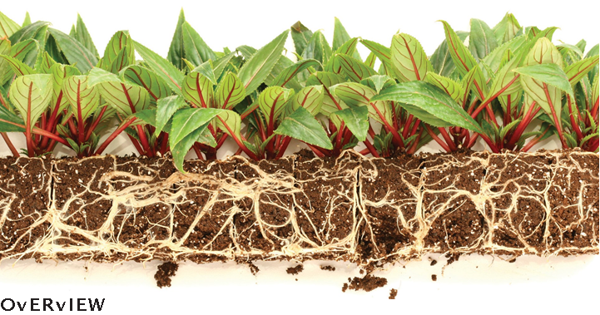
What we’re learning!
By the end of this lesson, you’ll be able to:
explain the roles of diffusion and active transport in moving nutrients from the soil to the plant;
describe the formation of soil and soil horizons; and
describe the events in the Great Dust Bowl, how
they relate to soil horizons, and how those events affected agricultural practices.
Notes:
OBJECTIVES
After completing this lesson, students will be able to:
explain the roles of diffusion and active transport in moving nutrients from the soil to the plant;
describe the formation of soil and soil horizons; and describe the events in the Great Dust Bowl, how
they relate to soil horizons, and how those events affected agricultural practices.

Slide 4
Virtual Classroom – Lesson Introduction
Notes:
For more virtual classroom videos, visit the Nutrients4Life YouTube channel.

Slide 5
How does a plant obtain nutrients?
Notes:
Activity 1: From Soil to Roots (page 93)
Remind students that in the previous lesson they learned that there are air spaces in soil. These air spaces can be filled with water containing dissolved nutrients. Ask, “How does the plant obtain nutrients from the water that is in the soil?”
Students’ responses will vary. If necessary, guide the discussion to mention the plant’s root system.
Bonus, can the students identify the plant in the slide. Answer: strawberry plant.

Slide 6
Agree or Disagree?
Plant roots have tiny hairs that absorb water.
Plant roots use energy to pump water into the plant.
Nutrients enter root cells through the process of diffusion.
Nutrients enter root cells through the process of active transport.
Plant roots grow until they find water.
Notes:
Activity 1: From Soil to Roots (page 93)
Display a copy of Master 3.1 (page 104), what do you know about roots? Use a piece of paper to cover all but the first statement. Read the first statement and ask the students to indicate by a show of hands whether they agree or disagree with the statement.
This discussion is designed to help you assess the students’ prior knowledge of the topic. If necessary, review for the class the essential features of diffusion and active transport. (The next two slides)
After students vote on each statement, ask for one or two volunteers to explain why they voted as they did. At this time, do not correct wrong answers.
Answers and explanations are revealed to students in Step 15 on page 95 (slide 15).
True
False
True
True
False

Slide 7
Diffusion
High Concentration
Low Concentration
Notes:
Teacher notes:
Review diffusion briefly for students:
Molecules move randomly due to their kinetic energy.
This movement causes molecules to intermingle.
The net movement of molecules is from an area of higher concentration to one of lower concentration.
The net movement of molecules stops when the concentration of molecules is the same everywhere.
The movement of the molecules comes from their kinetic energy and doesn’t need additional energy (unlike active transport).

Slide 8
Active Transport
Energy molecule
(ATP)
Low Concentration
High Concentration
Notes:
Teacher notes:
Review active transport briefly:
Active transport is a process used by cells to move molecules from an area of lower concentration to one of higher concentration.
It requires energy.
If your students already have been introduced to the energy molecule ATP, you may mention it as the source of energy for active transport.

Slide 9
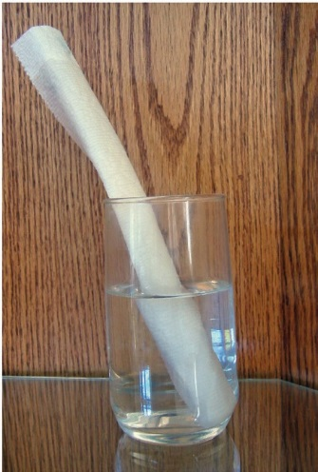
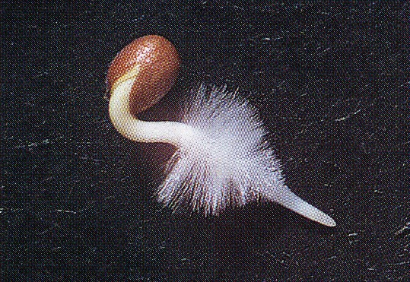
Root Systems: What do you see?
Materials for this activity: hand lens and a young seedling.
B
Notes:
ACTIVITY 1: FROM SOIL TO ROOTS
SEEDLING PREPARATION (page 92)
For this activity, any type of seeds may be used so long as the roots have grown about 1 or 2 cm. Pinto bean seeds are easy to obtain and work well. To germinate the seeds, place several seeds in a row along one side of a paper towel as shown in Figure 3.1a (page 92). Carefully roll up the paper towel from bottom to top. Place the rolled paper towel into a glass of water so that the seeds are at the top and out of the water glass (Figure 3.1b). Water will wick up through the paper towel and keep the seeds moist. Prepare enough seedlings so that each team of 4. Students will have a seed to observe. Assume that just 1/2 of the seeds you prepare will germinate. Set the glasses of seeds in a location where they will not be disturbed. The seeds will need approximately 5 to 6 days for the roots to grow enough for observation. During the germination period, be careful to replace any water that is lost through evaporation.
Explain that they will now investigate the mechanism by which roots obtain nutrients from the soil.
Divide the students into teams of 4.
Pass out to each team a young seedling (taken from the paper towel germination) and a hand lens. This activity refers to the way that most plants obtain their nutrients through the root system. Legumes that carry out nitrogen fixation in their roots are a special case and are not dealt with here.
Instruct the students to take a minute to observe the seedling’s root system with the hand lens and write down their observations on a piece of paper. The root hairs are white and very fine. Provide a dark background against which the root hairs are more easily visible.
After the students have recorded their observations, ask volunteers to describe what they saw. Students will report seeing one large root emerging from the seed. They also will describe fine white hairs growing out from the root.
Remind students of the first statement from Master 3.1, What do you know about Roots?: “Plant roots have tiny hairs that absorb water.” (Page 104) Ask, “Why do you think that plants have so many root hairs?” Student responses will vary.
Guide the discussion to bring out that more root hairs mean more surface area with which to contact water and nutrients in the soil. In Lesson 2, students learned about particle size and surface area. In this case, the small projections on the root are another example of the importance of increasing surface area.
Ask students, “How do nutrients in the soil water get into the root hairs?” Students’ responses will vary. At this time, accept all answers.

Slide 10
Try this! How does water enter root hairs?
Notes:
ACTIVITY 1: FROM SOIL TO ROOTS
Page 105
Explain that students will now investigate the process by which water enters the root hairs. Keep the class in their teams. Pass out to each team one copy of the Master 3.2, moving water and nutrients into roots.
Ask students to read over the procedure on the following slide. Explain that the cup represents the root hair, the larger container represents the water in the soil, and the food coloring represents the nutrients dissolved in the water.
After students have completed their investigations, reconvene the class and ask volunteers to explain what happened when the holes were poked through the cup.

Slide 11
How does water enter root hairs?
Fill the cup about ½ full of water.
Place the cup of water into the center of the larger container.
Fill the larger container with water until its level is the same as that in the cup.
Add several drops of food coloring to the water in the larger container and gently mix the water until the color is evenly distributed through the water. Do not add food coloring to the water in the cup!
Using a sharp pencil, poke two holes in the cup, opposite each other.
Watch the water in the cup for five minutes and record your observations.
Notes:
ACTIVITY 1: FROM SOIL TO ROOTS

Slide 12
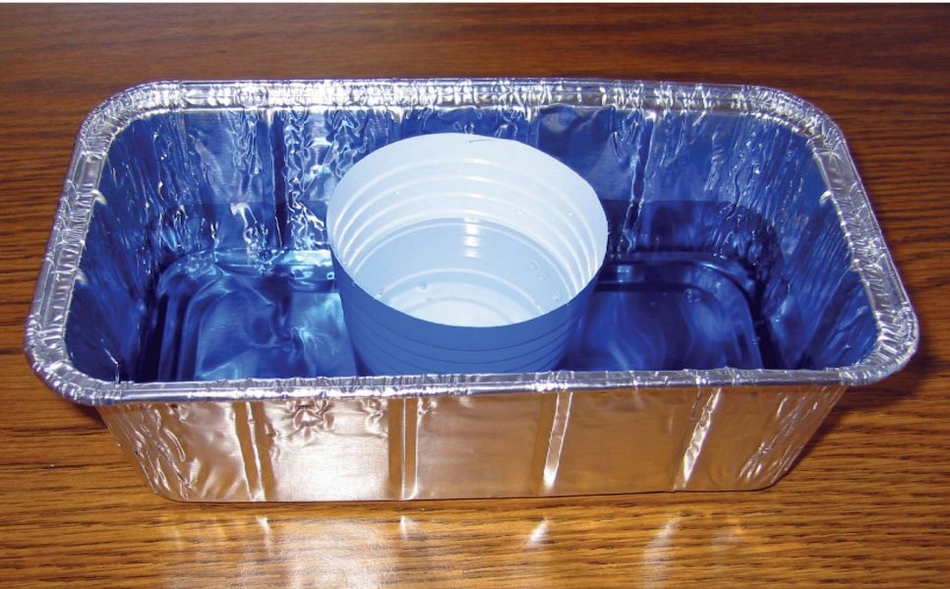
Think about it!
Why did the colored water enter the cup?
What is the process where a substance moves from an area of higher concentration to an area of lower concentration?
Where does the energy come from to drive this process?
Notes:
ACTIVITY 1: FROM SOIL TO ROOTS
Why did the colored water enter the cup?
Students responses will vary. Guide the discussion to bring out the fact that although the concentration of water was the same on both sides of the cup, the concentration of the food coloring was higher outside the cup compared with the inside of the cup.
What is the process where a substance moves from an area of higher concentration to an area of lower concentration?
The process of diffusion was summarized in Step 2 (slide 7). Students should recall that diffusion involves a net movement of a substance from an area of higher concentration to one of lower concentration.
Where does the energy come from to drive this process?
Students should recall from the discussion in Step 2 (slide 7) that the kinetic energy of the molecules in solution drives the process.

Slide 13
Experiments with Roots
Scientists measured the concentrations of various essential elements in the soil and inside the root hairs. They found that some essential elements had concentrations up to 100 times greater inside the root hairs compared with the soil.
What process can move a substance against its concentration gradient?
Notes:
ACTIVITY 1: FROM SOIL TO ROOTS
Experiment 1: Master 3:3 Experiments with Roots (page 106)
Ask the students, “What this data tells them about how nutrients move from the soil into the roots?”
Since the concentrations of some essential elements move from an area of low concentration to one of higher concentration, this suggests that energy was required for the movement and the process involved was active transport.
What process can move a substance against its concentration gradient?
Active transport

Slide 14
Experiments with Roots
The data from the previous slide cause the scientists to suspect that active transport was responsible for concentrating some essential elements in the root hairs. They next exposed the living roots to a chemical that stops the synthesis of ATP. Once again, they measured concentrations of essential elements in the soil and inside the root hairs.
What do you think they observed?
Notes:
ACTIVITY 1: FROM SOIL TO ROOTS
Experiment 2: Master 3:3 Experiments with Roots (page 106)
Read the second experiment and discuss its meaning.
Students should recognize that since the chemical halts ATP synthesis there would not be energy available to support active transport.
Without active transport, those essential elements that depend on active transport to reach high concentrations will exhibit much lower concentrations in the root hairs as compared with the first experiment.
Other essential elements that are transported by diffusion will be expected to have their concentrations unchanged.

Slide 15
Agree or Disagree?
Plant roots have tiny hairs that absorb water.
Plant roots use energy to pump water into the plant.
Nutrients enter root cells through the process of diffusion.
Nutrients enter root cells through the process of active transport.
Plant roots grow until they find water.
Notes:
ACTIVITY 1: FROM SOIL TO ROOTS
Conclude the activity.
Once again. as before, ask students to indicate by a show of hands whether they agree or disagree with each statement.
Ask volunteers to explain why they changed their minds about their answers. Students should be able to respond to the statements about roots as follows:
Answers to Master 3.1, What Do You Know about Roots? (page 104)
PLANT ROOTS HAVE TINY HAIRS THAT ABSORB WATER. (TRUE)
Students were able to observe root hairs using the hand lens. A larger root system contacts and absorbs more water than a smaller one.
PLANTS ROOTS USE ENERGY TO PUMP WATER INTO THE PLANT. (FALSE)
As shown in the demonstration, water enters the root hairs by the passive process of diffusion. When root hairs contact the water, the water flows from a higher concentration in the soil toward a lower concentration in the root cells.
NUTRIENTS ENTER ROOT CELLS THROUGH THE PROCESS Of DIFFUSION. (TRUE)
Water enters the root system by diffusion and takes some dissolved nutrients with it.
NUTRIENTS ENTER ROOT CELLS THROUGH THE PROCESS Of ACTIVE TRANSPORT. (TRUE)
As shown by the experiments described in Master 3.3, Experiments with Roots, some nutrients are moved by active transport. Students should recognize that both diffusion and active transport have important roles in moving nutrients into plants from the soil.
PLANT ROOTS GROW UNTIL THEY FIND WATER. (FALSE)
Students may believe that roots can sense and grow toward water. This is a misconception. Roots can only grow where water is already present. As the surface of the soil dries out, roots near the surface may die while roots further down are in contact with water and can grow still deeper.

Slide 16
Water-Nutrient Transport
Food coloring is transported up the celery stalk in the plant’s xylem system.
Notes:
Activity 2: From Roots to the Plant (page 96)
Celery Demonstration (page 92)
Use a sharp knife to cut celery stalks into pieces approximately 5 cm (2 inches) long. Make sure that the cut surfaces are flat and will allow the celery to rest upright when placed into the paper cups. Approximately 2–3 hours before class begins, put one piece of celery into a cup containing the food coloring. Wrap the other piece of celery in plastic wrap until needed.

Slide 17
The Plant Vascular System
Phloem transports sugars produced in the leaves during photosynthesis down the plant.
Xylem transports water up from the roots.
Notes:
Activity 2: From Roots to the Plant (page 96)
This activity helps students think about how plants have specialized tissues for moving water and nutrients from the roots to all other parts of the plant. Explain that getting nutrients into the plant roots is an important first step. Ask students, “How does water, and the nutrients it contains, get from the roots to the rest of the plant?”
Accept all reasonable answers at this time.
Hold up a piece of celery and a cup containing food coloring. Ask students to predict what the celery will look like after it has been in the food coloring solution for a while.
Do not correct misconceptions at this time. Students will come back to this in Step 4. If students are unfamiliar with the existence of a vascular system in plants, they may predict that the entire stalk of celery will be blue inside. If they know that plants have a vascular system, they would predict that there are specific places within the stalk that are blue (blue dots seen on the surface of the cut end).
Briefly review the information on the master so that students understand that plants have specialized mechanisms for moving water and nutrients.
Reconvene the class and hold up the piece of celery that has been in the food coloring. Ask volunteers to use what they have learned about the plant vascular system to explain why their earlier predictions were or were not accurate.
Students should see that the food coloring was transported up the celery stalk and was visible as a series of colored dots along the top of the stalk. Some students may have seen this demonstration before and remember what the result is, but have not thought about what it means about the existence of a specialized mechanism for transporting water and nutrients.
Reinforce that the movement of water took place through the plant’s xylem system, which explains why the food coloring was present in discrete places in the celery.
Conclude the activity by reminding students that photosynthesis produces sugars in the leaves. Ask them how the sugars, needed for energy, reach the lower parts of the plant.
Students should recall from Master 3.4, The Plant Vascular System that phloem tissue is used to transport sugars downward from the leaves. You can point out that in the case of the celery stalk, the xylem and phloem tissues lie next to each other in structures called vascular bundles.

Slide 18
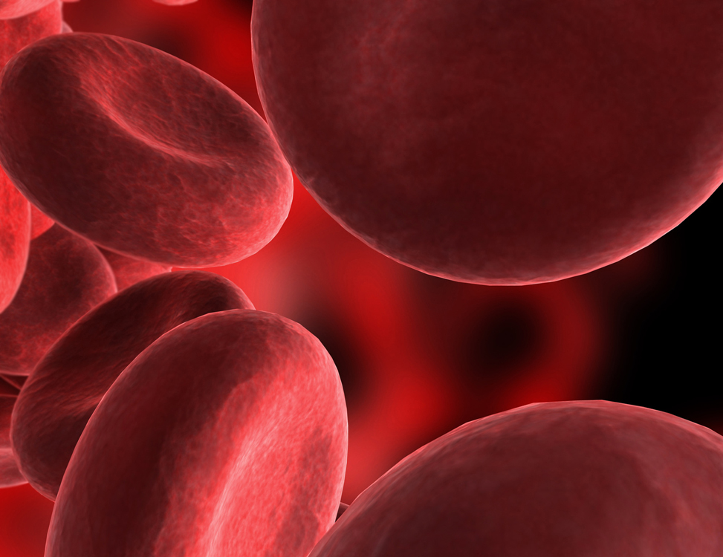
Writing Assignment:
Compare and contrast the plant vascular system to the human circulatory system.
Notes:
Activity 2: From Roots to the Plant (page 96)
Optional Homework Assignment
Ask students to write a short paper that describes how the plant vascular system is similar and dissimilar to the human circulatory system. Students’ descriptions should include the following:
Similarities
Both systems use a series of tube-like structures to transport material throughout the organism.
Both systems use diffusion to move nutrients and oxygen gas (O₂) into cells.
Plants have separate systems for moving water up the plant (xylem) and for moving food down the plant(phloem).
Humans have a separate system for moving oxygenated blood (arterial system) and non-oxygenated blood (venous system).
Dissimilarities
The human circulatory system uses the heart to pump blood, while the plant vascular system lacks such an organ.
Blood in the circulatory system contains cells, while the sap in the plant vascular system does not contain cells.
Capillaries join the arterial and venous systems, but there are no similar structures in the plant vascular system.

Slide 19
Soil Formation and Horizons: What do you notice about this picture?
Notes:
Activity 3: Soil Formation and Horizons (page 97)
Master 3.5 (page 108)
Ask students to make observations about the soil they see in the pictures.
The main observation that students should make is that there appear to be layers in the soil that differ by color and thickness.
Explain that soil includes layers and that the layers are called soil horizons.

Slide 20
Notes:
Activity 3: Soil Formation and Horizons (page 97)
Master 3.6 (page 109) Where does soil come from?
Ask students to work in teams of 2-3 to make and record observations.
Give teams 2–3 minutes to write brief observations.
In the next step, students will get additional information.

Slide 21
Notes:
Activity 3: Soil Formation and Horizons (page 97)
Master 3.6 (page 109) Where does soil come from?
Ask students to work in teams of 2-3 to make and record observations. Give teams 2–3 minutes to write brief observations. In the next step, students will get additional information.
Give each student a copy of Master 3.7, Soil Formation. Instruct them to use the information on this master to add information and detail to the descriptions they wrote on Master 3.6.
Encourage students to talk with their team members as they work through this. It may be helpful if students use a different color pen or pencil to make their changes or additions. In this way, they can easily see how their initial observations compare with the new information they are adding. Students can also make notes on Master 3.7 to cross-reference the steps on Master 3.6.
It may be helpful to point out to students that the cross-section of soil represented on Master 3.6 is the same total thickness throughout. Soil is formed through the breakdown of bedrock and addition of organic materials. It is not formed only by the addition of material on top of bedrock.

Slide 22
Factors in Soil Formation
Parent Material
Environmental Concerns
Terrain
Living Organisms
Time
Human Influences
Notes:
Activity 3: Soil Formation and Horizons (page 97)
Use Master 3.7 (page 111).
Conclude the activity by reviewing the information on Masters 3.6 And 3.7. Explain to students that horizons in soils from different areas are likely to be different—some thicker or thinner.
This is also an opportunity to go back to what students have learned about soil in Lesson 2. In that lesson, students learned about soil texture and the dependency that plants have on getting water and nutrients from the soil. In this activity, students have learned about the soil horizons in which roots grow.

Slide 23
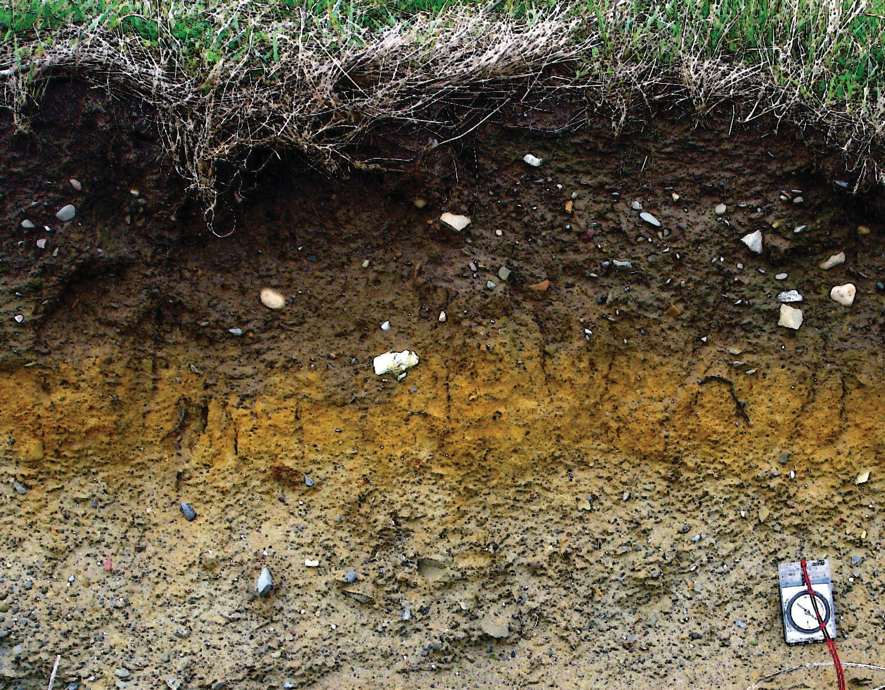
What factors contribute to the disruption of the soil horizons?
Which soil horizon is most important to plant health?
Notes:
Activity 4: The Dust Bowl (page 97)
In this activity, students investigate the relationships between farming practices and protecting the topsoil.
Remind students that in the previous activity they learned about the formation of soil and soil horizons. Explain that although it takes many years to form fertile soil, it can be destroyed in a relatively short time .
Ask, “What factors do you think contribute to the disruption of the soil horizons?” Student responses will vary. Some will mention natural factors such as weather (hot and dry) while others may mention human influenced factors such as farming practices.
Explain that students are going to investigate a severe example of soil destruction that occurred in the great plains region of the united states back in the 1930s .
Students should recall that the topsoil (layer A) contains minerals and organic materials that are important to plant health.

Slide 24
The Dust Bowl: American History Connection
Weather
Economy
Farming Practices
overestimation of the region’s rainfall
an extended drought
high winds
large influx of settlers who began farming
Russian Revolution and World War 1 causes crop prices to rise which led to more land farmed
US government land grants to farmers
increased use of mechanized farming.
overproduction of wheat
onset of the Great Depression
increased use of mechanized farming
practice of “deep plowing”
leaving soil unprotected
Notes:
Activity 4: The Dust Bowl (page 97-98)
Pass out to each student 1 copy of Master 3.8, Disrupting The Soil Horizons: The Dust Bowl. (page 112)
Instruct students to read the handout and on a separate piece of paper.
Describe how the dust bowl was related to: weather conditions, economic conditions, farming practices. If appropriate, assign this for homework.
After students have completed their assignment, reconvene the class.
Ask volunteers to report how the weather, economy, and farming practices contributed to the creation of the Dust Bowl.
Explain that the most important government response to the dust bowl was to encourage farmers to change their farming practices.
To conclude the activity, teams will look more closely at farming practices and their effects on the soil.

Slide 25
The Dust Bowl & Farming Practices
The cruel lesson of the Dust Bowl is that topsoil is a precious resource that must be protected.
Some of the challenges associated with maintaining healthy soils include nutrient depletion, erosion, and water runoff.
Different farming practices have been developed to address these challenges.
Notes:
Activity 4: The Dust Bowl (page 97-98)
Arrange students in teams of 2–3. Pass out to each team 1 copy of Master 3.9, Farming Practices (page 113). Instruct the teams to read the short descriptions of farming practices and to follow the directions on the handout .
Give teams about 10–15 minutes to discuss the farming practices and write down their conclusions.
Ask for volunteers to report their conclusions about each farming practice . Teams should report the following:
Crop rotation addresses the problem of nutrient depletion. By rotating crops with different nutritional requirements, one crop can restore to the soil an essential element that was removed by the previous crop.
Strip farming addresses the problem of soil erosion. The roots help hold the soil together. Positioning the cultivated strip perpendicular to the prevailing winds minimizes erosion from the bare strips.
Contour farming addresses the problem of water runoff. The furrows made by the plow (perpendicular to the slope) serve as dams that slow water runoff during rainstorms.
Explain that return of rain to the great plains, the end of the Great Depression, and the implementation of better farming practices helped the country recover from the Dust Bowl. Ask, “Do you think the us could ever experience another dust bowl? Why or why not ?”
Student responses will vary. Some students may believe that the lessons learned from the 1930s will enable toady’s farmers to avoid the mistakes of the past. Other students may be concerned that global warming may lead to another Dust Bowl.

Slide 26
What challenge does this practice address?
Crop Rotation: Long ago, farmers discovered that growing the same crop in the same field year after year led to unhealthy plants and decreased crop growth. To address this problem, farmers use crop rotation. They plant crops with different nutrient requirements one after the other in the same field. The aim is to strike a balance so that not all of the crops are depleting any given nutrient in the soil.
Notes:
Activity 4: The Dust Bowl (page 97-98)
Master 3.9, Farming Practices (page 113)
Crop rotation addresses the problem of nutrient depletion. By rotating crops with different nutritional requirements, one crop can restore to the soil an essential elements that were removed by the previous crop.

Slide 27
What challenge does this practice address?
Strip Farming: This practice involves dividing the field into parallel, long, narrow strips. The strips are organized so that they are perpendicular to the prevailing winds. Every other strip is planted with seed while the strips in between are left unplanted.
Notes:
Activity 4: The Dust Bowl (page 97-98)
Master 3.9, Farming Practices (page 113)
Strip farming addresses the problem of soil erosion. The roots help hold the soil together. Positioning the cultivated strip perpendicular to the prevailing winds minimizes erosion from the bare strips.

Slide 28
What challenge does this practice address?
Contour farming involves plowing a field along its elevation lines. This means that the ruts formed by the plow run perpendicular to the slopes. The furrows form level curves around the field. This keeps rain from running rapidly downhill, causing erosion.
Notes:
Activity 4: The Dust Bowl (page 97-98)
Master 3.9, Farming Practices (page 113)
Contour farming addresses the problem of water runoff. The furrows made by the plow (perpendicular to the slope) serve as dams that slow water runoff during rainstorms.

Slide 29
Are Soil Horizons Still in Danger?
The amount of dust blown across the landscape has increased over the last 17 years in large swaths of the West, according to a study led by the University of Colorado, Boulder.
For the new study, the research team set out to determine if they could use calcium deposition as a proxy for dust measurements. Calcium can make its way into the atmosphere—before falling back to Earth along with precipitation—through a number of avenues, including coal-fired power plants, forest fires, ocean spray, and, key to this study, wind erosion of soils.
The amount of calcium dissolved in precipitation has long been measured by the National Atmospheric Deposition Program (NADP), which began recording the chemicals dissolved in precipitation in the late 1970s to better understand the phenomenon of acid rain.
Brahney and her colleagues reviewed calcium deposition data from 175 NADP sites across the United States between 1994 and 2010, and they found that calcium deposition had increased at 116 of them. The sites with the greatest increases were clustered in the Northwest, the Midwest, and the Intermountain West, with Colorado, Wyoming, and Utah seeing especially large increases.
Other areas of the world are more affected by dust movement than is the US. For example, satellite images have tracked large amounts of dust moving all the way from Africa to South America.
Notes:
Activity 4: The Dust Bowl (page 97-98)
Master 3.10 Dust Study (page 114)
Ask a volunteer to read the study aloud the slide (or Master 3.10 on page 114) to the class. Ask, “Does this data cause you to revise your thinking about a return of the Dust Bowl?”
Some students may be surprised by these findings and think that another Dust Bowl is more likely than before.
Explain that scientists believe that this increase in dust emissions may be due to several factors including increased windstorm frequency, drought cycles, and changes in land use patterns. This movement of dust can have significant effects on both the area where the dust is removed and the area where it is deposited.
If students are interested, they could do additional research on the Internet to learn more about topsoil depletion in different areas of the world and how topsoil depletion in one area can have consequences in a very different part of the world. For example, scientists can track dust traveling from Africa across the Atlantic Ocean. Some studies are finding wide-ranging effects, including damage to the health of coral reefs in the Caribbean.

